Slide 1
Surveying
BASIC DEFINITIONS

Slide 2
plan
Transformation of things from sheet to earth.
MAP
Transformation of things from earth to sheet.

Slide 3
Difference

Slide 4
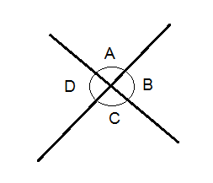
AnGLE
The difference in direction of two intersecting lines in movement.

Slide 5
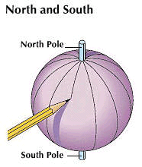
The earth surface
The earth is not a true sphere and a slightly flattened at the poles. It polar axis is somewhat smaller in length (about 43.45 km) than that of its equatorial axis.

Slide 6
The earth surface
Any section of the earth parallel to the equator is a Great circle and any of its section parallel through the pole is an ellipse.

Slide 7
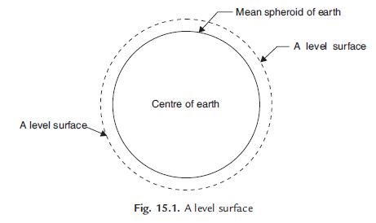
LEVEL SURFACE
“ Any surface which is parallel to the mean spheroidal of the earth is called as level surface.”
Level surface is the curved surface every point lying upon the level surface will be at an equal distance from the center of the earth.

Slide 8
Spheroid
“Spheroid is the curved line which is perpendicular to the direction of gravity.”
LEVEL LINE
“Level line is that line which lies on a level surface.”

Slide 9
MERIDIAN
“It is line defined by the intersection of an imaginary plane, passing through the poles and any point on the earth surface level.”

Slide 10
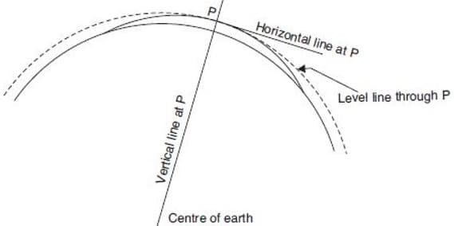
Horizontal PLANE and line
“Any place like glass sheet which is tangent to the level surface at any point is called as Horizontal plane.”
Through any point on the earth’s surface, there can be only one horizontal plane but infinite horizontal lines.
“Any line which is lying on the horizontal plane is called Horizontal line.”

Slide 11
Vertical plane and line
“A line through a point is perpendicular to the horizontal line is called Vertical Line.”
“Any plane passing through that point and containing the vertical line is termed as Vertical Plane.”
Through any point on the earth surface, there can be only one vertical line but infinite vertical planes.

Slide 12
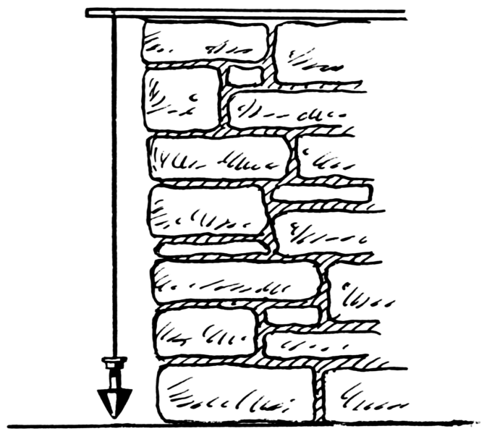
PLUMB LINE
The direction of the lines of force of earth's gravity field. In field surveying, it is defined by the direction of a freely suspended plumb-bob.

Slide 13
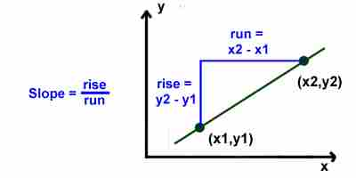
GRADE
It is defined as slope of line. It is also called as gradient.
Rise means how many units you move up or down from point to point. On the graph that would be a change in the y values. Run means how far left or right you move from point to point. On the graph, that would mean a change of x values

Slide 14
DATUM/ reference surface
A datum is a reference point from which measurements are made. It is an assumed surface used as a reference for the measurement of height and depth.
Reduce Level (R.L)
Reduce level of a point is vertical distance of point above or below datum.
When height is increase reduce level also increase.

Slide 15
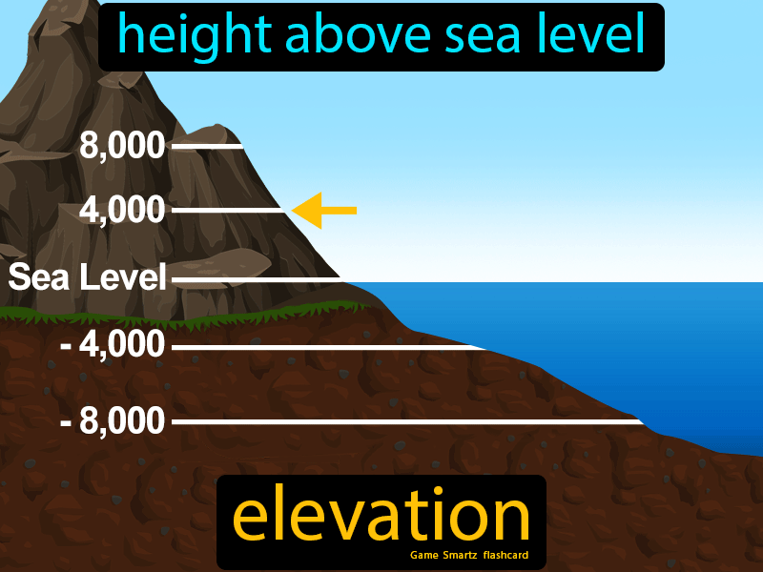
ELEVATION
It is vertical distance of point above or below the reference surface (Datum). When elevation are with respect to the earth’s surface , the datum is the mean sea level.

Slide 16
Sea level
Mean sea level is an average level of the surface of one or more of Earth's bodies of water from which heights such as elevation may be measured.

Slide 17
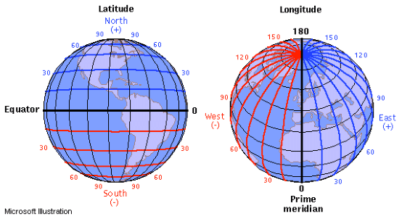
LATITUDE
Measurement of a position north or south of the equator is called latitude.
LONGITUDE
Measurement of how far a position is east or west is called longitude.

